Slide 1
Color Sorter Machine
BY
ADHISH VELINGKAR -1613129
SAHIL RAJPURKAR - 1613130
SHUBHAM KHANDHAR - 1723002
BHAVIN PRAJAPATI - 1723003

Slide 2
Introduction
For sorting object in industry optical sorting is very much convenient. Color and size are the most important features for accurate classification and sorting of product which can be done by using some optical sensors or analyzing their pictures.
This project describes a working prototype designed for automatic sorting of objects based on the color. OPT101 sensor was used to detect the color of the product and the STM microcontroller was used to control the overall process. The identification of the color is based on the ADC value of the output of OPT101 sensor.
Two Servo motors were used, each controlled by the microcontroller. The first motor is used for carrying the product to be analyzed by the color sensor, and the second motor is used for sorting the product according to the reading taken by the color sensor, into the separate containers.

Slide 3
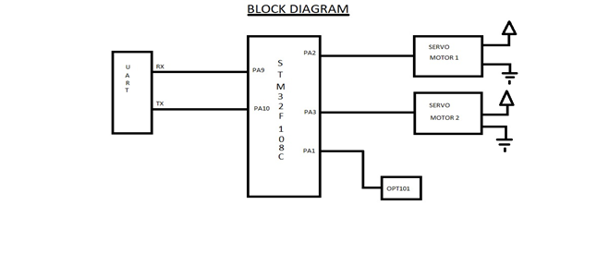
Block Diagram

Slide 4
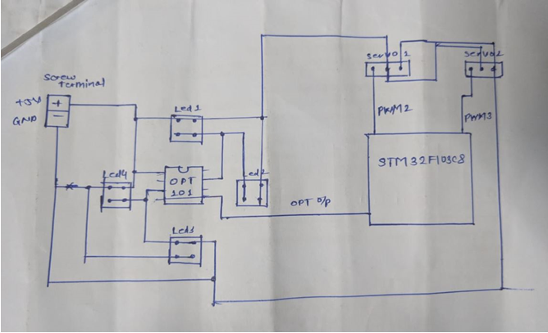
Interfacing Diagram /Schematic

Slide 5
Description of each component
A servo motor is an electrical device which can push or rotate an object with great precision. If you want to rotate and object at some specific angles or distance, then you use servo motor. It is just made up of simple motor which run through servo mechanism.
We have made a sensor which is a combination of OPT101 photodiode IC and piranha LED’s.
The OPT101 is a monolithic photodiode with on-chip trans-impedance amplifier.
In order to control the motors and the sensor we used the STM32F103C8 of STM32F103xx family.
All devices offer two 12-bit ADCs, three general purpose 16-bit timers plus one PWM timer, as well as standard and advanced communication interfaces: up to two I2Cs and SPIs, three USARTs, an USB and a CAN. The devices operate from a 2.0 to 3.6 V power supply.

Slide 6
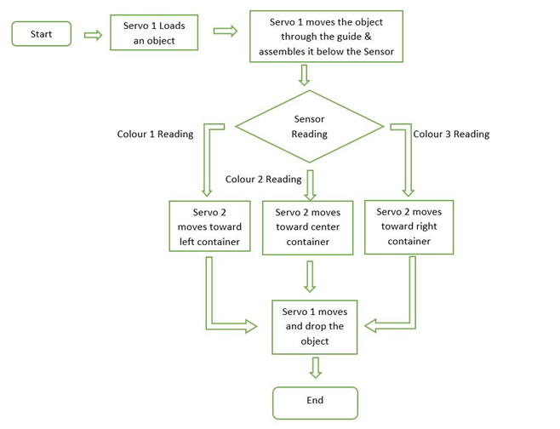
Flowchart

Slide 7
Future Scope
The model can be improved by making some changes in the program and components. Some suggestions are given below.
We can add a load cell for measurement and control of weight of the product.
We can also add a counter for counting the number of products.
Speed of the system can be increased accounting to the speed of production.
The system can be used as a quality controller by adding more sensors.
The sensor can be changed according to the type of product.
The servo motor can be replaced with stepper motor.
The STM can be replaced with PLC.

Slide 8
References
https://en.wikipedia.org/wiki/Colour_sorter
https://howtomechatronics.com/how-it-works/how-servo-motors-work-how-to-control-servos-using-arduino
http://www.ti.com/product/OPT101
image.dfrobot.com/image/data/DFR0269/STM32F103C8T6.pdf
https://info.pcboard.ca/led-specifications/superflux-piranha-led-specifications/

Slide 9
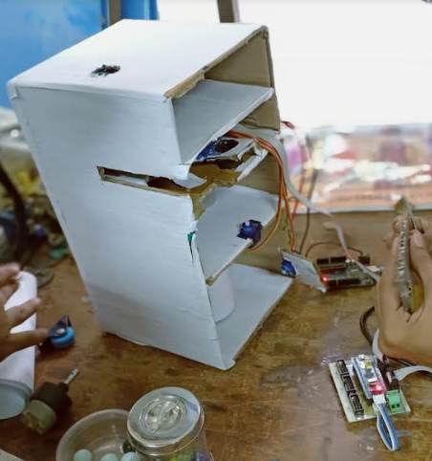
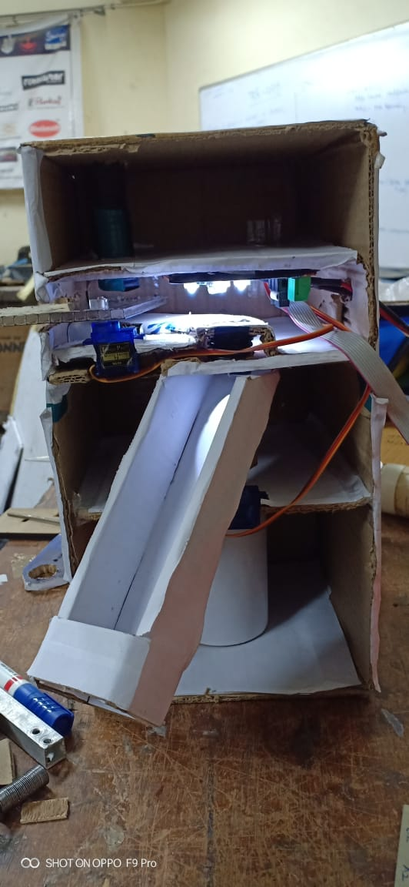
Design and Output

Slide 10
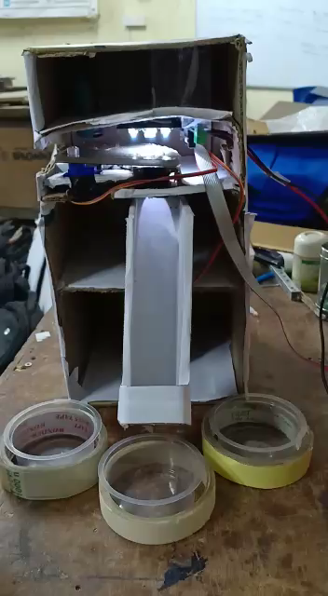
Final Working

